Slide 1
Transition to Locke
New Solutions to Mind/Body Problem
Rejecting Rationalist Theory of Knowledge
New Empiricist Alternative Offered

Slide 2
Mind/Body Problem Redux
How to avoid RD’s solution to Mind/Body Problem:
Depends on Diagnosis of the Source of the Problem
Is it a consequence of Substance Dualism?
Or is it a consequence of Property Dualism?
If Substance Dualism, then you can…
Do Away with Minds: Materialist Monism (Hobbes)
Do Away with Bodies: Immaterialist Monism (Leibniz)
If Property Dualism, then you can…
Be a Substance Monist/Property Monist, Immaterialist Branch (Leibniz)
Be a Substance Materialist, Property Dualist (Locke/Aristotle?)
Be a Substance Materialist, Property Monist (Churchland-ish Eliminativism)

Slide 3
Empiricist Starting Points
Central thesis: If we are to know the world, given our sole source of contact with that world is through sense perception, sense perception is the faculty of knowledge.
Motivation: Subjectivist Turn in Meditation II (to know the World, must know the Mind first)
Main Consequence
No ideas originating independently of sense perception can be trusted to represent the world accurately.
Main Obstacle to this Thesis
The Doctrine of Innate Ideas (Leibniz,
Descartes, Spinoza)

Slide 4
Locke Against Innate Ideas
Locke Attacks Two Different Doctrines of Innate Ideas:
Simple Possession Doctrine: the mind actually possesses innate ideas as soon as the mind exists. (Tools-in-the-Toolbox analogy)
Subtle (Disposition to Acquire) Doctrine: All minds have a disposition to acquire these ideas under the right conditions.

Slide 5
Arguments Against the Simple Doctrine
Lack of consensus: general population fails to agree about the truth status of propositions that presuppose grasp of these innate ideas. (uneducated, children, mentally-challenged)
Even if there is consensus, this does not prove any of these propositions is true: consensus does not ever establish the truth of any proposition.
Consensus does not establish that the associated ideas are innate: They could be the result of childhood development and have their origins in sense perception, not reason acting on its own.

Slide 6
Arguments Against the Subtle Doctrine
1. Do all minds get these ideas even when reasoning under the ‘right conditions’? Answer: No. Many do not.
Rejoinder (RD): the claim is not that all minds get these ideas, but that all minds that use the right method for discovering/acquiring them will. You can think you have the right conditions and be mistaken.
2. Either you have an idea or you do not start here next time (Acquaintance Thesis about Concept Possession). If you acquired it having at some time lacked it, then it is not innate).

Slide 7
Rejoinder (JP): The empiricist cannot claim that any idea that is acquired is not innate unless they can show that the origin of all mental content lies in something coming from outside the mind. This is not satisfied by this objection. So, it begs the question.
Example: Chomsky on the innate idea of a ‘verb’ or RD on the idea of infinity.

Slide 8
Locke on Ideas and Mental Powers
Idea: "That which comes before the mind/that which is the object of the mind when it thinks.“
There is an ambiguity in this definition since both mathematical ‘objects’ and perceptual ‘objects’ come before the mind. Common sense suggests the latter are ‘external’ to the mind, and the former are ‘internal’. The former represent abstract objects like numbers, perfect triangles, etc. But do the latter also represent? If so, common sense is incorrect (since a ‘representation’ is internal to the mind), and Locke’s definition of the ‘idea-idea’ entails indirect realism about objects.

Slide 9
Locke’s Empiricist Model of Mind
World
Entities---> Blank tablet + God-given mental powers-->ideas
Input ---> Mind -->output
Notice: “God-given mental powers” are innate to the mind, on Locke’s account, and so with respect to the powers of mind Locke, too, is an innatist. He is just not an innatist about mental content (what he thinks are the products of these powers of mind when active, i.e., ideas).
On this model, the origin of ideas lies in external things perceived through the literal content of sense perception.

Slide 10
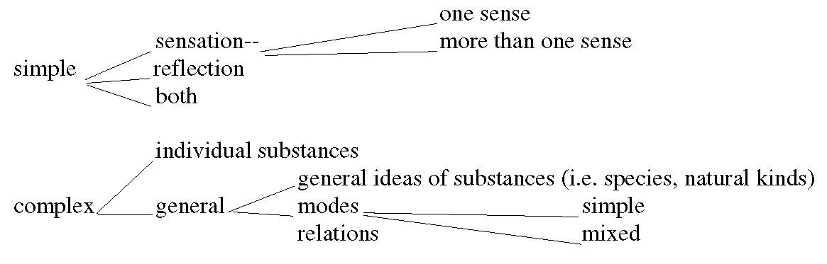
Locke’s Taxonomy of Ideas/Types of Ideas

Slide 11
Locke’s Acquisition Thesis
All ideas are either simple or complex, and complex ideas are built up from simple ideas through either a) combination or b) abstraction.
Two Consequences
Limits of Intelligibility
Philosophical Analysis
Locke on Abstraction
F B W
(Concept of White)

Slide 12
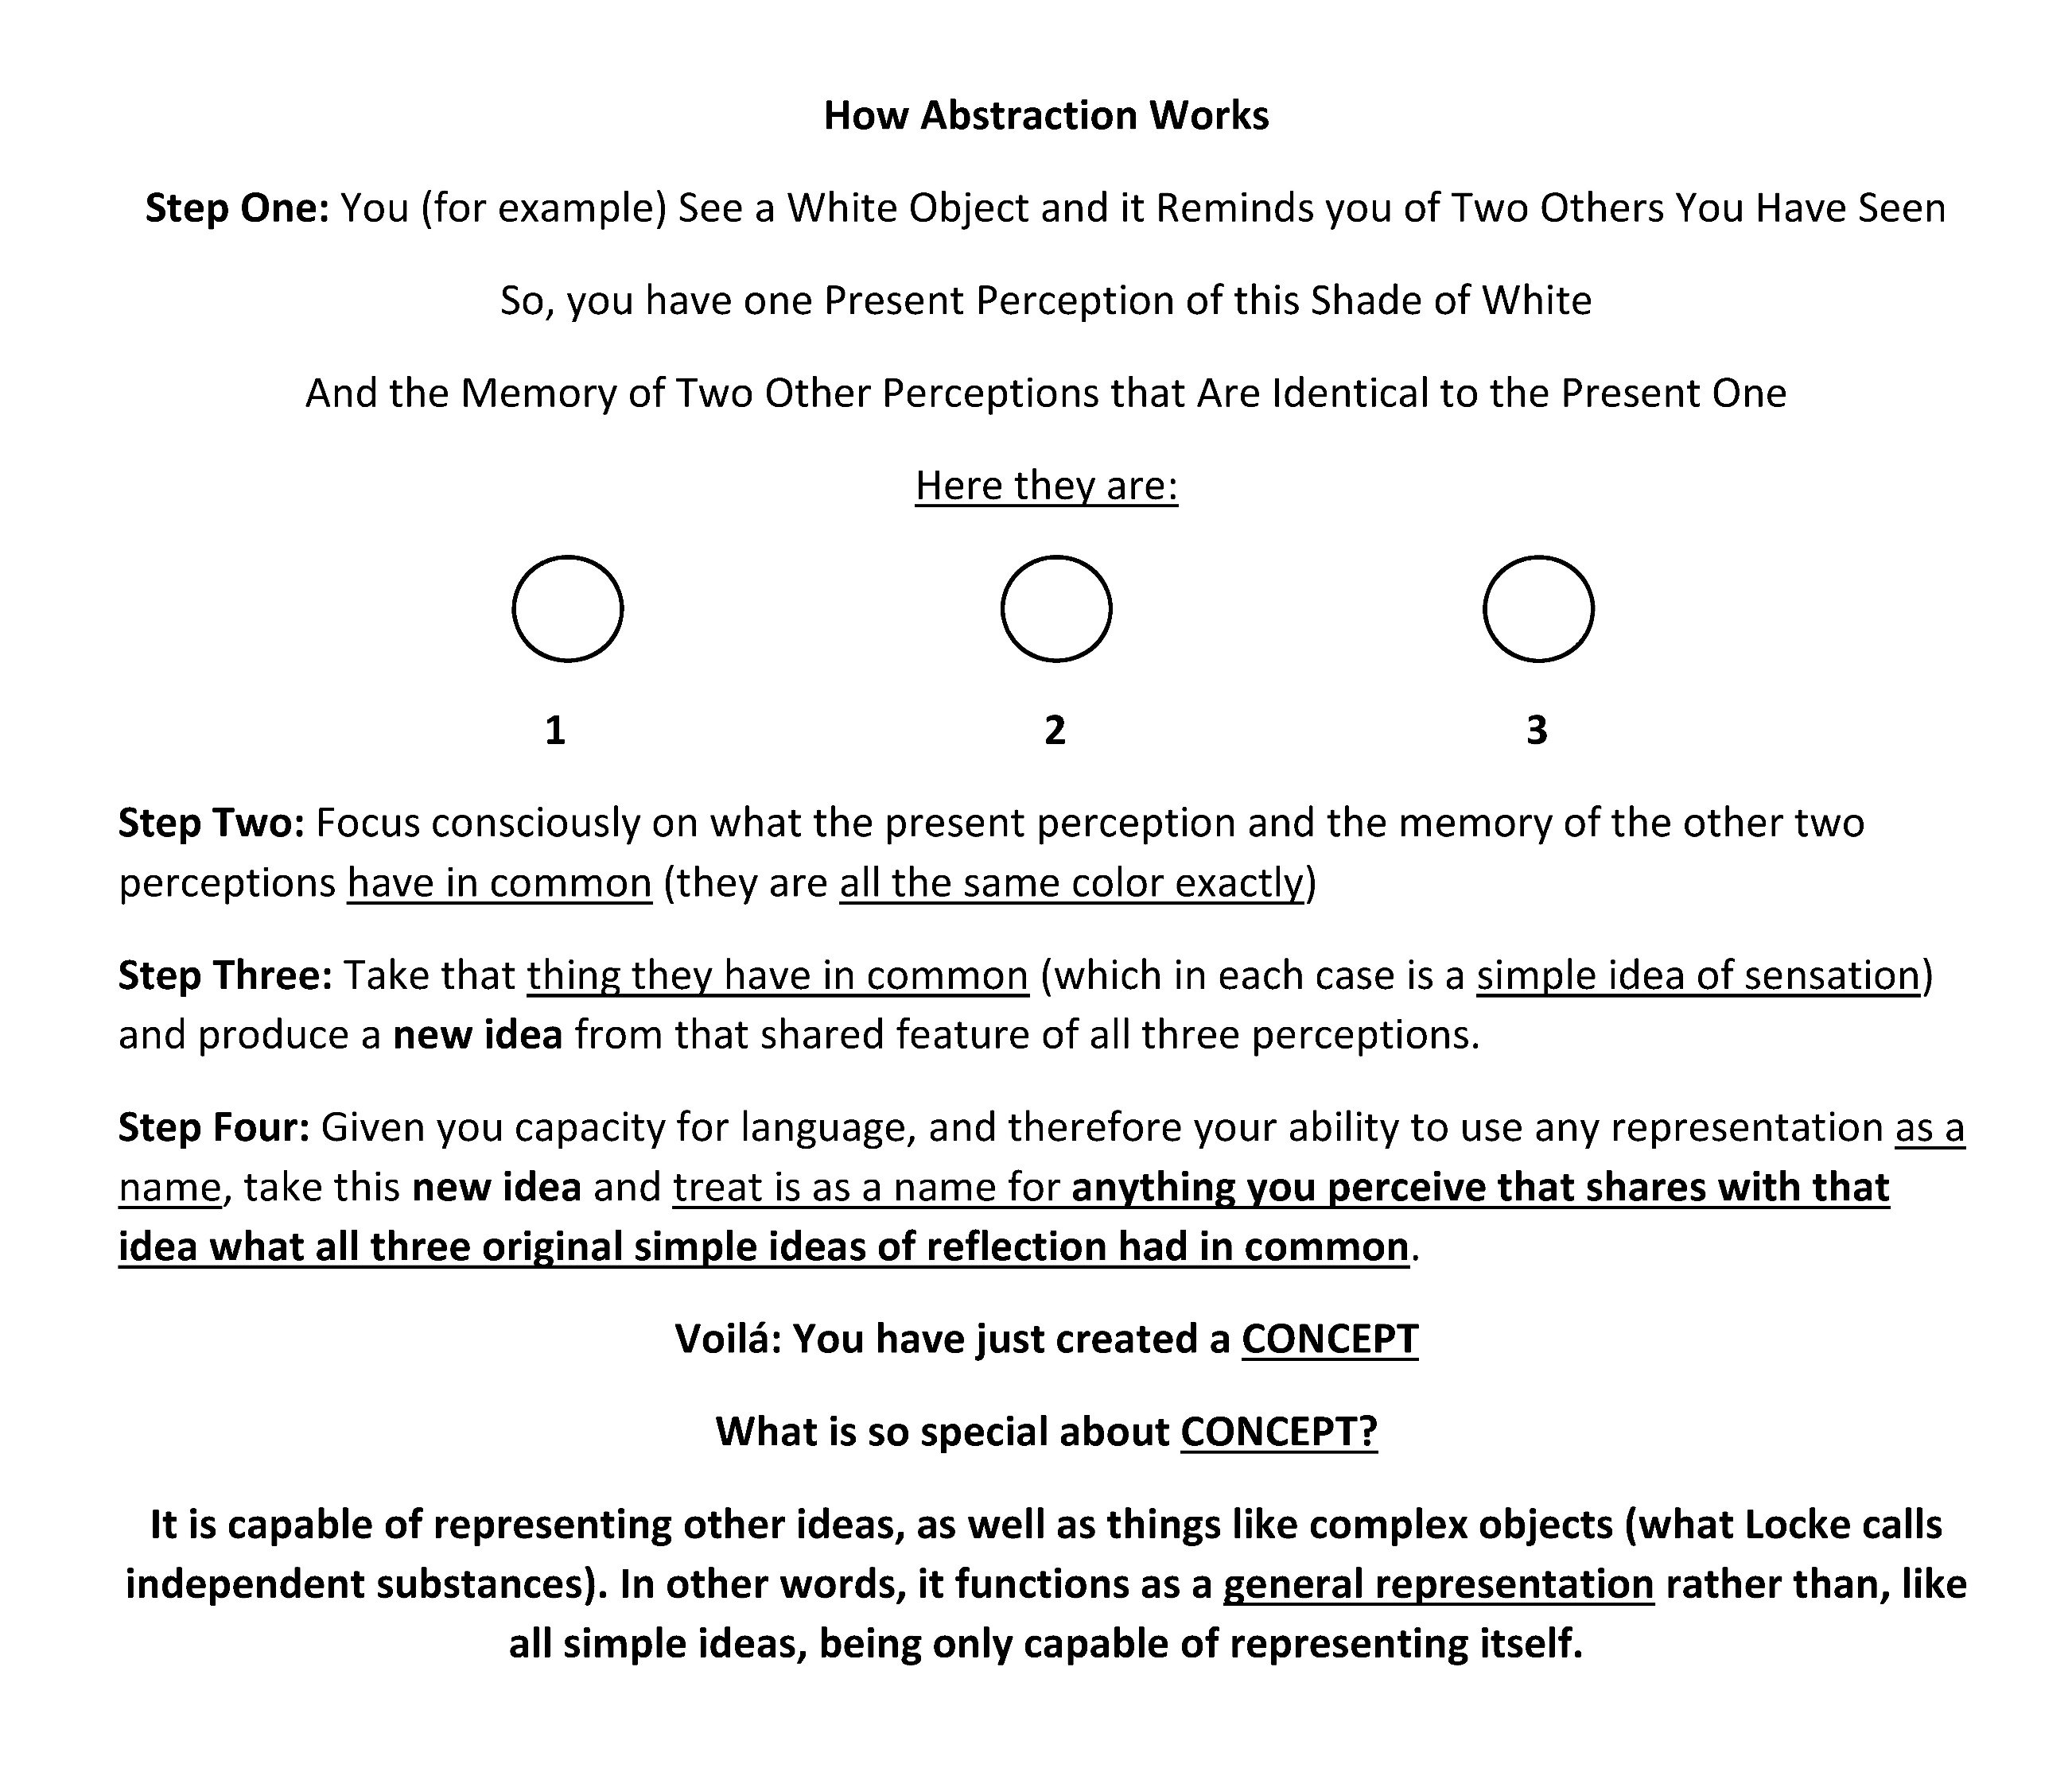

Slide 13
Locke on Perception
To perceive is: to have simple ideas of sensation appear in the window of consciousness.
Three Consequences
Direct vs. Indirect Object of Perception
Perceptual Atomism
Simple ideas never invented
Molyneux’s Problem
The Blind Man Test: If a congenitally blind person who knows geometry were to be given sight and asked to distinguish two 3D objects (a Cube and a Sphere) presented for them to gaze upon, could they tell which was the Cube, which the Sphere?
Locke’s Answer
No, because each involves a concept, and the blind person lacks a visual concept of either object.

Slide 14
Two Consequences of Molyneux’s Problem
Atomic ideas come first, and are uninterpreted
Simple ideas are neither invented nor innate
Locke on Primary and Secondary Qualities
Quality: the power of an object to produce an effect (simple idea of sensation) in the mind.
Primary Quality (PQ): power of an object to produce a simple idea of sensation that resembles its cause in the object.
Secondary Quality (SQ): power of an object to produce a simple idea of sensation that fails to resemble its cause in the object.
Idea of a PQ (IPQ): simple idea of sensation caused by PQs in the object that resembles its cause in the object.
Idea of an SQ (ISQ): simple idea of sensation caused by the object that fails to resembles its cause in the object (which is always a PQ, but misperceived as an SQ)

Slide 15
Some Distinctions
PQs vs. IPQs
SQs vs. ISQs
Tertiary Qualities (TQs) vs. Ideas of Tertiary Qualities (ITQs) [ISQs always intervene]
How to tell whether a simple idea of sensation is an IPQ or an ISQ or an ITQ: check to see if the idea arises in more than one sense. If it does, then it is an IPQ, not an ISQ or ITQ.
Two Problems with Locke’s PQ/SQ Distinction
Problem I (Berkeley's): how to tell PQs from SQs (without sense-independent access to objects)
Problem II (Plato's): do either IPQs or ISQs ever necessarily represent objects accurately?
Examples: (i) same distal object/different proximal stimuli
(ii) different distal objects/same proximal stimuli

Slide 16
Locke’s Theory of Corporeal Substance
So what's a substance? (Individual objects (aka “lowercase s” substances) or Sub-stance (that which “stands under” the properties of anything that exists [from Aristotle])
L's critique of traditional metaphysical realism: since we lack perceptual access to Sub-stance, and only have access to simple ideas of sensation, which are what we take to be the properties of individual objects, objects are knowable only as “bundles of sensible properties”, some of which exist as they appear (IPQs) and some of which do not (ISQs)
L's cautious epistemological (scientific) realism: all objects of human experience can only be known as bundles of sensible properties, some of which are directly perceivable (IPQs) and some of which are not (ISQs). For the latter, he appeals to the "corpuscularian" hypothesis to capture the "real internal constitution" of individual substances (particular objects).

Slide 17
Locke’s Critique of Metaphysical Physical Substance
Since individual substances (particular objects of perception) consist in nothing more than bundles of sensible properties based on concepts of their properties derived from simple ideas of sensation, we cannot know the Sub-stance that stands under those properties.
But the individual identity of physical objects, for metaphysical realists, is established by appeal to both its essential properties (the object’s “form”) and the Sub-stance that these properties uniquely inhabit. Identity is therefore a product of the combination of perceivable sensible properties and unperceivable Sub-stance in which they exist.
New Problem: how to establish the identity of physical objects over time given Lockean empiricism about the nature of objects?
Answer: Fortunately, no two physical objects can occupy the same space at the same time, so that fixes their identity.

Slide 18
Locke's Critique of Metaphysical Mental Substance
Given that individual physical substances can only be known by way of their sensible properties, what about mental substances (i.e., human minds)?
Locke’s answer is that a mind is an individual substance that consists of Something-I-Know-Not-What (the Sub-stance in which its properties, represented by concepts of reflection drawn from simple ideas of reflection, reside) plus the ideas of reflection our experience with our own minds reveals as essential to us.
This leads to a view of minds in which human beings consist in thinking bodies w/o souls [immaterial Sub-stances]).
New Problem: but the identity of individual minds has been accounted for by metaphysical realists as a combined consequence of the Form of the mind (for Locke = bundle of essential ideas of reflection) and its Sub-stance (soul).

Slide 19
This generates Locke’s “Problem of Personal Identity”
If the identity of a mind (which is the same thing as the identity of a person as Locke defines ‘person’ [=the unique mind of an individual human being] cannot, given the lack of access to the Sub-stance (immaterial Sub-stance [aka Soul]) in which the bundle of essential mental properties of the mind were thought to reside, I can know myself only by means of the impressions (ideas of reflection) left by the effect on my awareness of my mental powers being exercised, and whatever underlies these is a SIKNW, how do I establish who I am and distinguish myself uniquely from all other minds?
Important Caveat: ‘human being’ is not a Person for Locke.
He makes this clear in his story about the cobbler and the prince, in which he entertains the possibility, given that mind and body are not obviously the same thing, the mind-as-perceived must be regarded as distinct from the mind-body composite that = a human being.

Slide 20
The Problem of Personal Identity (PID) cont’d
Why we need to know who each of us is: praise, blame and responsibility are impossible to assign without being able to specify individual identity of persons over time. Without it, we cannot evaluate events involving actions of individual persons that have moral significance.
If my ID depends on my body, how to tell if I am same person after death?
What if god puts me in a different body?
If my body changes, do I become someone else?
Locke's Analysis of PID
(PID): x is one identical person iff x can extend the same self-consciousness over a present conscious perception of at least a certain set S of memories.

Slide 21
Some Problems with Locke’s Analysis
Problem I: lapses in self-c'ness; lapses in c'ness
L's response: (PID*)
Problem II: Thomas Reid's objection
A: flogged child
B: brave in battle
C: became a general
L's response: (PID**: see the reading. Hint: does set S of memories need to remain perfectly unchanged over time, with nothing that was ever important lost, or can sufficiently many preserved PID?)
Problem III: Split Brains
L’s possible response? (Since Locke doesn’t insist that minds [or bodies] are Substances, why not accept that persons are caused by brains, and if one brain can become two in one human being, that body can house two persons (with partially shared history!)

